Slide 1

Building AI-Powered Solutions for Assisting Visually Impaired Individuals

Slide 2
About me
Hello, I'm Angad Gupta, currently pursuing a Bachelor of Technology (B-Tech) degree in Computer Engineering at RK University.
I want to learn data science because it's incredibly useful. It has a big impact on different industries and can help find important information in complicated data. Learning about data science is not just interesting, but it also gives me lots of chances to work in cool areas like artificial intelligence, machine learning, and generative ai.
Below are my GitHub and LinkedIn profiles:
GitHub: https://github.com/Angad143
LinkedIn: https://www.linkedin.com/in/angadgupta143/

Slide 3
Problem Statement
This project aims to leverage Generative AI to assist visually impaired individuals in perceiving and interacting with their surroundings.
Visually impaired individuals often face challenges in understanding their environment, reading visual content, and performing tasks that rely on sight.
There is a need for an intelligent, adaptable, and user-friendly solution that provides:
Real-time scene understanding.
Text-to-speech conversion for reading visual content.
Object and obstacle detection for safe navigation.
Personalized assistance for daily tasks.

Slide 4
Project Objectives
Develop an AI-powered application that assists visually impaired users by providing:
Real-Time Scene Understanding: Interpreting and describing visual surroundings.
Text-to-Speech Conversion: Making textual content accessible through audio.
Object and Obstacle Detection: Ensuring safer navigation.
Personalized Assistance: Delivering tailored support for specific daily tasks.

Slide 5
AI-Powered Application Overview
A user-friendly web application built using advanced AI technologies to assist visually impaired individuals.
Key Features:
Users can upload images to analyze their content.
The app generates a detailed textual description of the image for understanding the scene.
Extracted text is converted into audio for seamless accessibility.
Objects and obstacles within the image are identified and highlighted to enhance situational awareness.
Personalized guidance is provided based on the context of the image.

Slide 6
Key Features and Workflow
Real-Time Scene Understanding
Use of advanced AI models to analyze the uploaded image and generate descriptive text.
Text-to-Speech Conversion
Optical Character Recognition (OCR) extracts text from the image and converted into audible speech using AI-powered TTS engines.
Object and Obstacle Detection
Identify key objects or obstacles in the image using computer vision models (Yolov5).
Personalized Assistance
Provide task-specific guidance based on the uploaded image, such as recognizing items, providing context-specific information.

Slide 7
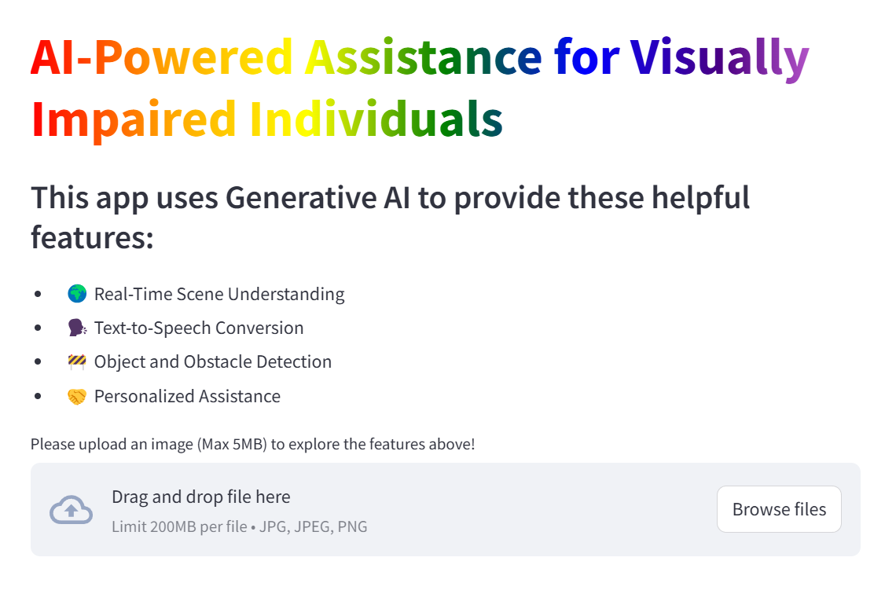
User Interface and Output
The interface is built using Streamlit, ensuring accessibility and ease of use for visually impaired users.

Slide 8
Tools and Technologies Used
LangChain:
Makes the app communicate in simple, natural language..
Streamlit:
Simplifies the creation of interactive and accessible web applications.
Google Generative AI:
Powers advanced descriptive text generation for scene understanding.
OCR (Tesseract or Google Vision API):
Extracts text from images with high accuracy.
Computer Vision Models:
Implements object detection algorithms for obstacle recognition.

Slide 9
What Makes This Project Special?
Unique Idea: Using AI to make everyday life easier for visually impaired people.
Useful Features: All the key tools in one app – scene descriptions, text reading, and safety features.
Accurate Results: Reliable and works well in real situations.
Well-Documented: Easy to understand and improve for future use.

Slide 10
Conclusion and Future Scope
This app demonstrates how AI can enhance the lives of visually impaired individuals by providing real-time scene understanding, text-to-speech, object detection, and personalized assistance. It empowers users to interact with their environment more independently and safely, improving their daily experience.
Benefits:
Makes them more independent.
Helps them feel more confident in daily life.
What’s Next?
Add video analysis for real-time help.
Make it work on phones for easier use.
Add support for more languages.

Slide 11

THANK YOU

